Slide 1
65 mph to zero
Curbing abrupt maintenance issues with a predictive maintenance plan

Slide 2
Business Problem
We run a company of car rental based on car-sharing business model. We are deciding whether to solicit cars from the public or invest in our own car fleet. The most important factor of consideration is how much it will cost to maintain the fleet of a certain type of cars.
This will be a recurring analysis as the makeup of the fleet changes due to ongoing maintenance, customer total wrecks, recalls, or any other realistic scenarios we forecast that may occur.

Slide 3
Ingestion and data description
Instance: 1728
Attributes: 5
Buying
Maintenance
Doors
Person
Lug-Boot
Target Variable: Maintenance
Low
Medium
High
We are not dropping any features because they important attributes that describe the characteristics of a car.

Slide 4
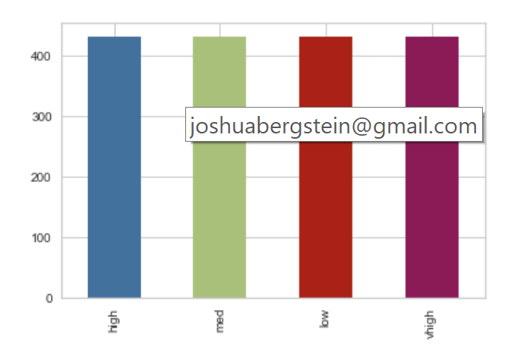
Munging and Wrangling
We made sure that there were no nulls
We converted numerical features into numerical datatypes (i.e. doors, persons).
We one_hot encoded categorical features.
Incidentally, we did not need to rebalance classes.

Slide 5
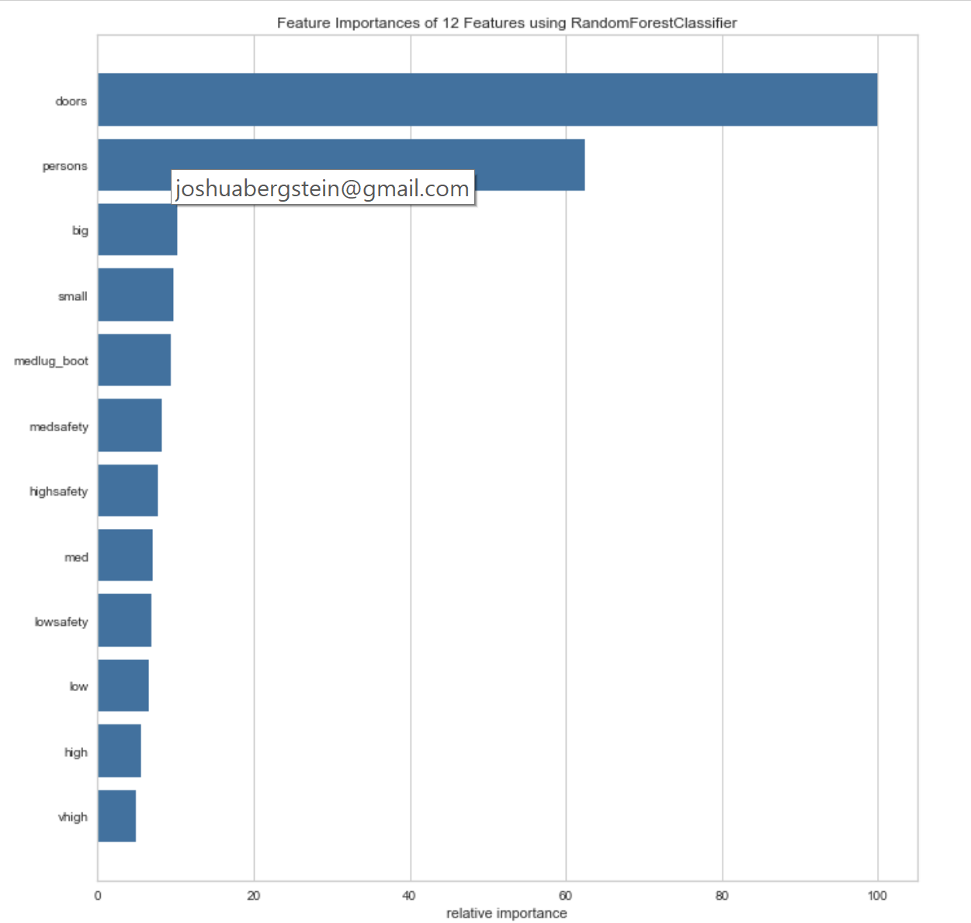
Computational Analysis
Random Forest data set
It’s a classification problem, we have labeled data, it’s a small data set, therefore, ensemble models works best

Slide 6
Modeling and Application
We trained a variety of ensemble estimators including gradient boost classifiers and random forests.

Slide 7
Reporting and Visualization
We would visualize a confusion matrix to evaluate the model. We would then make a dashboard that we could plug in. This would allow us to compare different cars we may want to invest in.
We could make an App using Flask that would allow us to visualize this iterative process.

Slide 8

Q/A

